Slide 1


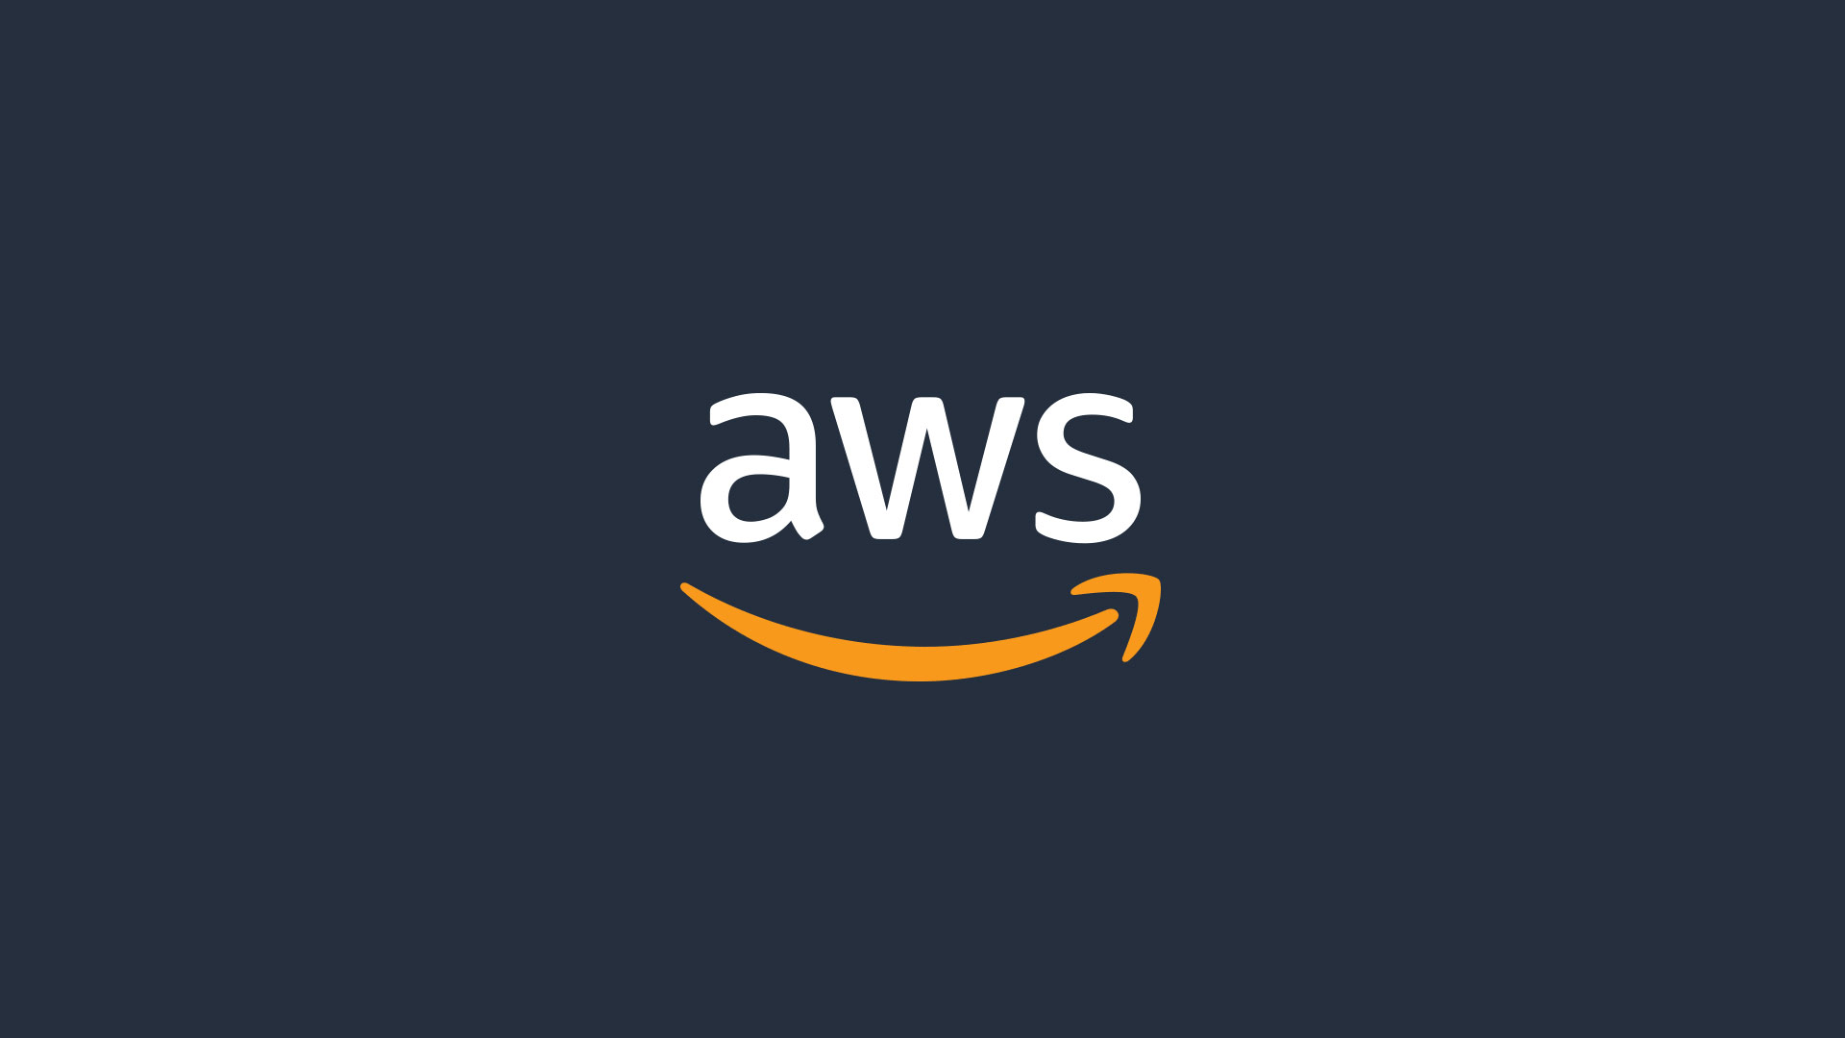

AMAZON WEB SERVICES
INSTRUCTOR: LAVISH ARORA
M.DHARSHITH (21A31A05H8) 02-07-2024

Slide 2
Case study 1:
Assume I have 2 branches in different locations and my nature of business is service based and I also want to host my app and dynamic website as well as database also.
Objectives:
• Create an architectural diagram to depict various AWS services and their interactions with each other.
• Estimate the cost of using services by using the AWS Pricing Calculator.
• Deploy a functional web application that runs on a single virtual machine and is backed by a relational database.
• Architect a web application to separate layers of the application, such as the web server and database.
• Create a virtual network that is configured appropriately to host a web application that is publicly accessible and secure.
• Deploy a web application with the load distributed across multiple web servers. • Configure the appropriate network security settings for the web servers and database.
• Implement high availability and scalability in the deployed solution
.• Configure access permissions between AWS services

Slide 3
FLOW CHART
Create the number of users required and allocate permission by using IAM services
Launch EC2 instances and Setup RDS for database
Configure Load Balancer and Usage of S3 for storage
Select Appropriate AWS Services and estimate them by price calculator
Configure the VPC subnets and networking

Slide 4
ARCHITECTURE DIAGRAM

Slide 5
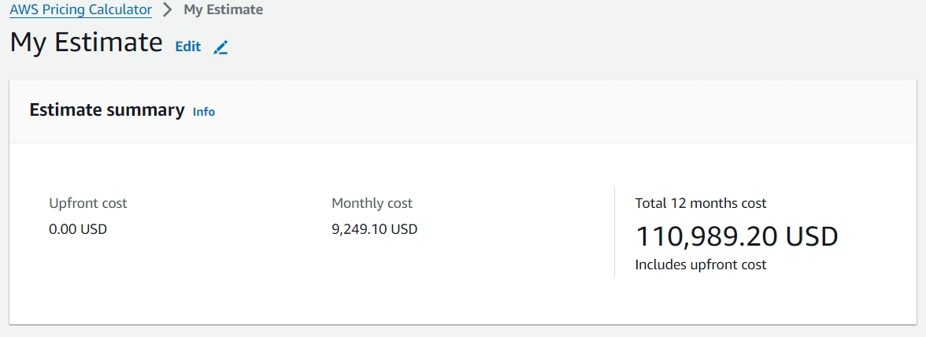
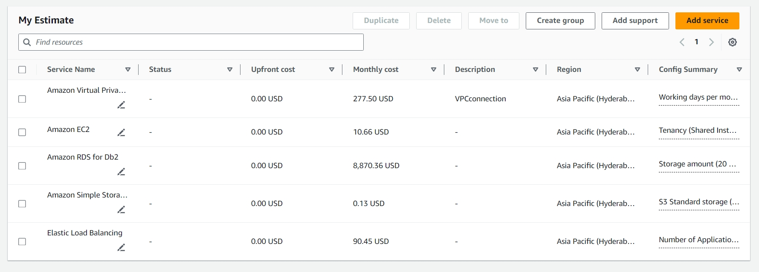
Select Appropriate AWS Services and estimate them by price calculator
In this step we first estimate all the services that are required for our project to run such as IAM for users, VPC to setup networking, EC2 to create instances and RDS for database storage and S3 buckets for storing the data.
By using AWS Price Calculator , we can estimate the upfront cost for our project as well.

Slide 6
The AWS services and Common components for a web application includes:
VPC (Virtual Private Cloud): To create a secure network for your services.
Subnets: Public and private subnets within the VPC.
Internet Gateway: To allow access to the internet for resources in public subnets.
NAT Gateway: To allow resources in private subnets to access the internet.
EC2 Instances: For web servers and application servers.
Elastic Load Balancer (ELB): To distribute traffic across multiple EC2 instances.
RDS (Relational Database Service): For the database.
S3 (Simple Storage Service): For static files and backups.
Route 53: For DNS management.
Security Groups: To control inbound and outbound traffic.
IAM (Identity and Access Management): For access control.
WAF (Web Application Firewall): For security against web attacks.
CloudWatch: For monitoring and logging.

Slide 7
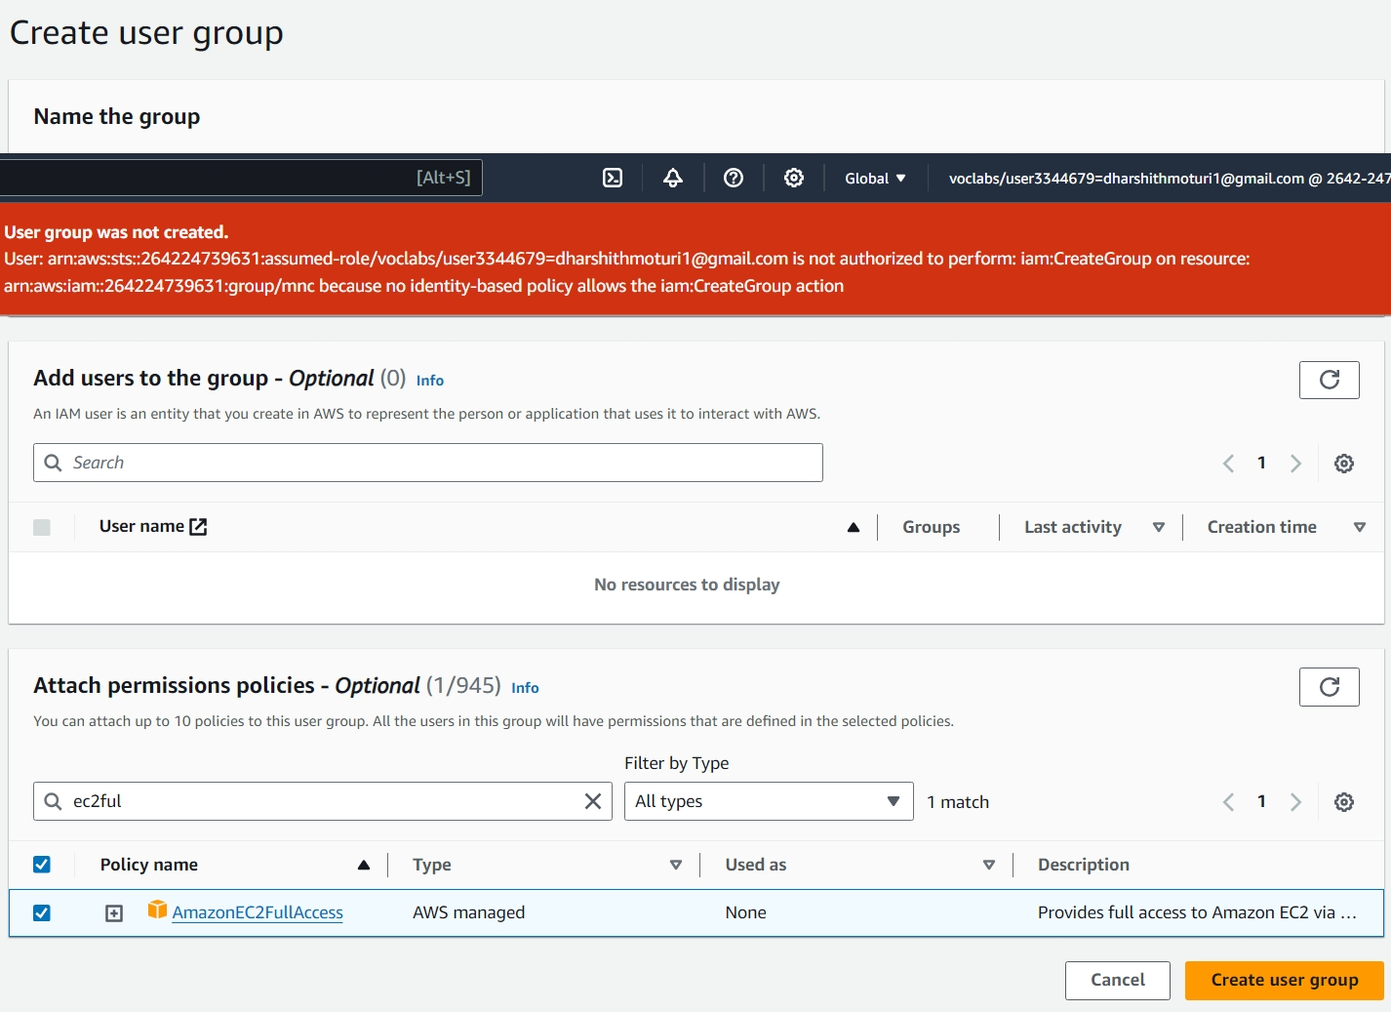
Add IAM Roles and Policies:
IAM: Illustrate IAM roles and policies connected to different AWS services for access control.
How to use IAM Services:
1)Come to AWS Dashboard.
2)Type IAM User in search -> IAM
3) We can create new user
4)If group is required user is required
along with group creation
How to create a User Group:
1)First open IAM dashboard
2)On LHS, Click on user group and
click on create group
3)Complete details such as
Full Name
Permission->EC2 Full Access

Slide 8
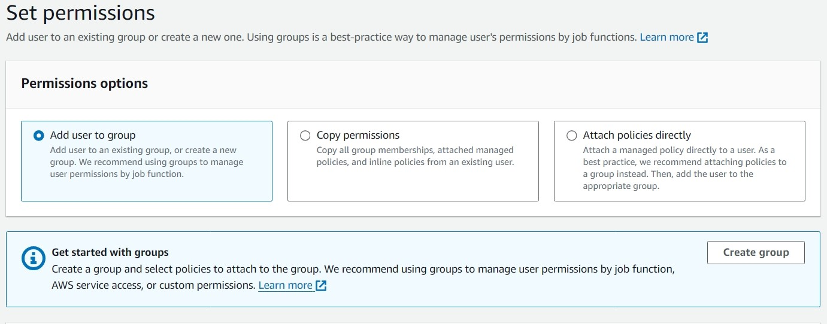
How to create USER:
Click on user →Add user → give username like student1 → check mark on AWS management console→ check mark on custom password like abc@1234 → click on next permission → click on add user to group → you can see existing group name like CloudTest otherwise you can create new group.
Check mark old group name cloud test→ click on next tags→ give key name like permission testing→ give value name OU name like sales→ then download csv file → you can see link → copy the link then open new tab paste the link you can new user name account now give username like Lavish and give password like race@123 → otherwise you can open AWS login account you can see there are two options 1st one is root and 2nd is IAM → select IAM then give username and password like Lavish and race@123.

Slide 9
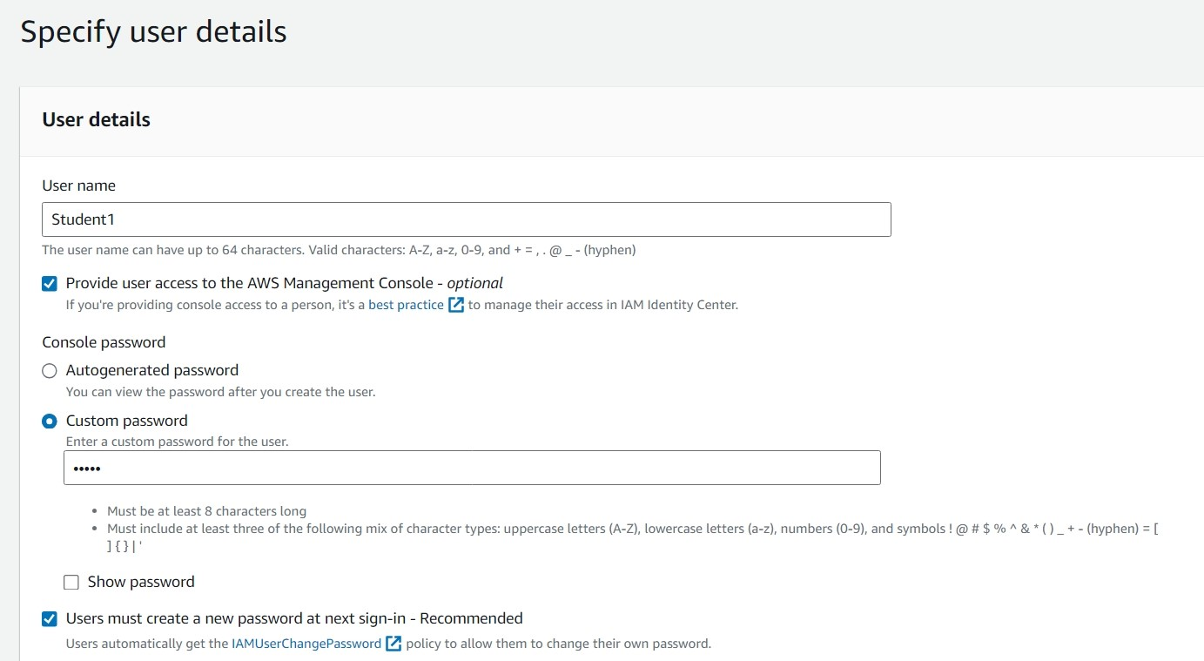

Slide 10
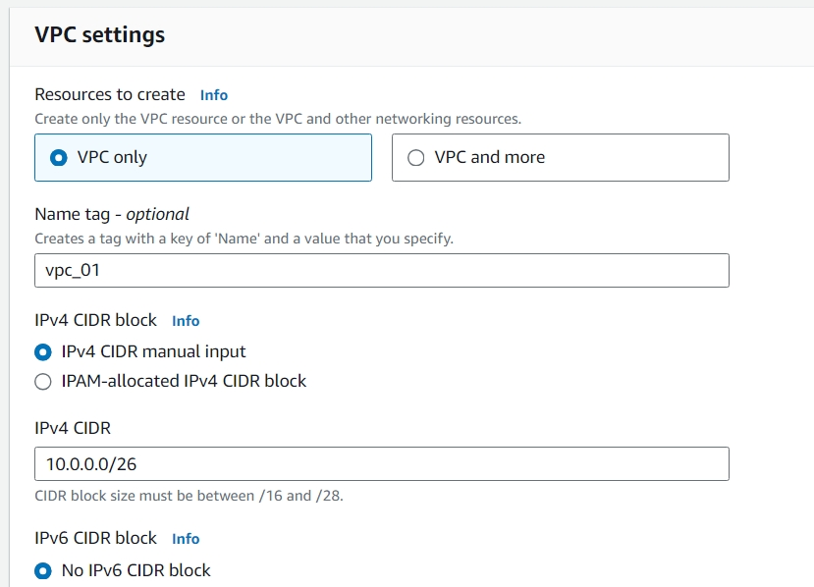
Create the VPC and Subnets Layout:
VPC (Virtual Private Cloud): A virtual network dedicated to your AWS account where you can launch AWS resources in a logically isolated section of the AWS cloud.
Subnets: Segments within a VPC that allow you to group resources based on security and operational needs, each containing a range of IP addresses.
How to create VPC:
1)Come to VPC dashboard there we can see default VPC is already created.
2)Now click on create VPC and give name tag like test_vpc.
3)Give Ip like 10.0.0.0/26 and checkmark no ipv6 cidr block
4)Then click on create to create your VPC.

Slide 11
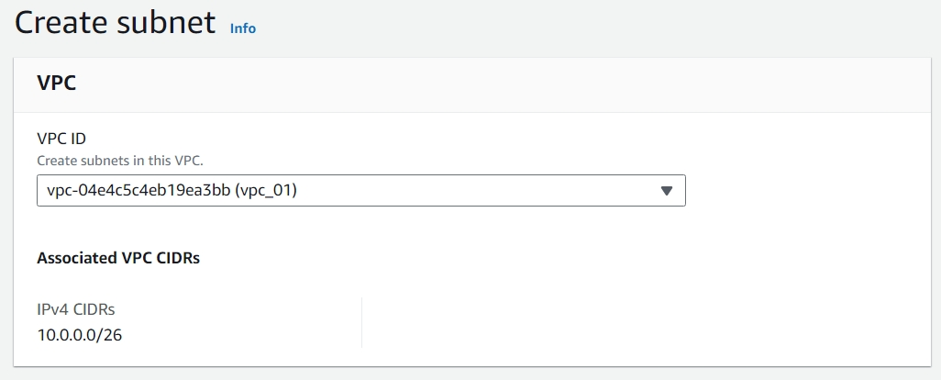
How to setup Route Table:
Come to route table and we can observe the VPC that is created. Now select manual VPC.
Click on subnet association and then click on edit. Now checkmark 2 public subnet public 1,2 and click on save.
Now create custom route table by clicking on create route table and give name as testvpcprivater1 and select manual VPC.
Click add tag name like name and give value as value: private and click create.
Now select testvpcprivate1 and click subnet association and then edit.
Now checkmark private subnet 1,2 and click save.4)
Then click on create to create your VPC.
How to create Subnet:
1)Click on subnet and give name tag as public-subnet-1
2)Then select test VPC and select availability zone like a1
3)Now we decide range of Ip for each subnet.
4)Then click on create.
In this way we creates 4 subnets in which 2 are public and 2 are private.

Slide 12
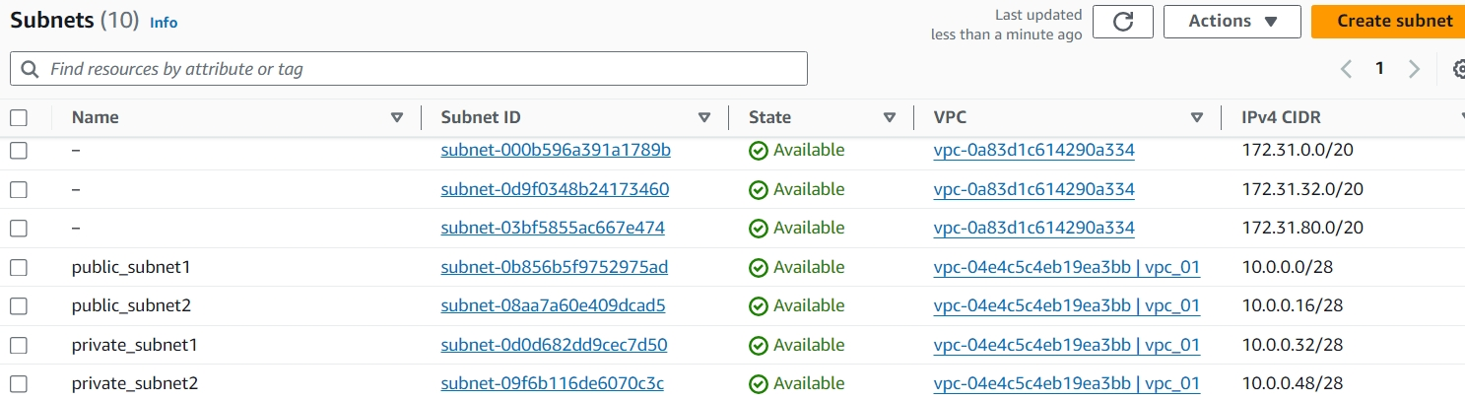
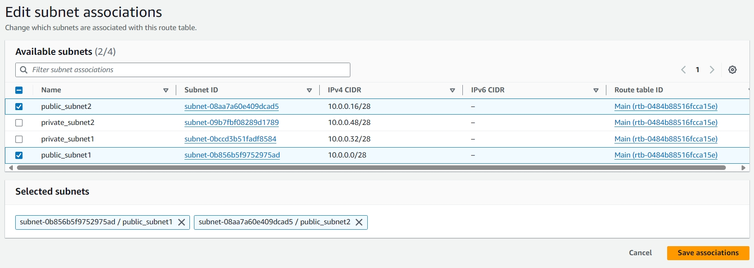
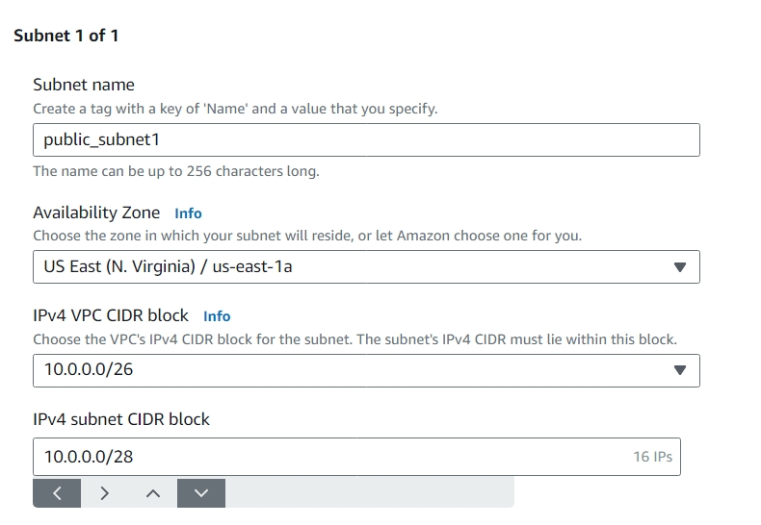
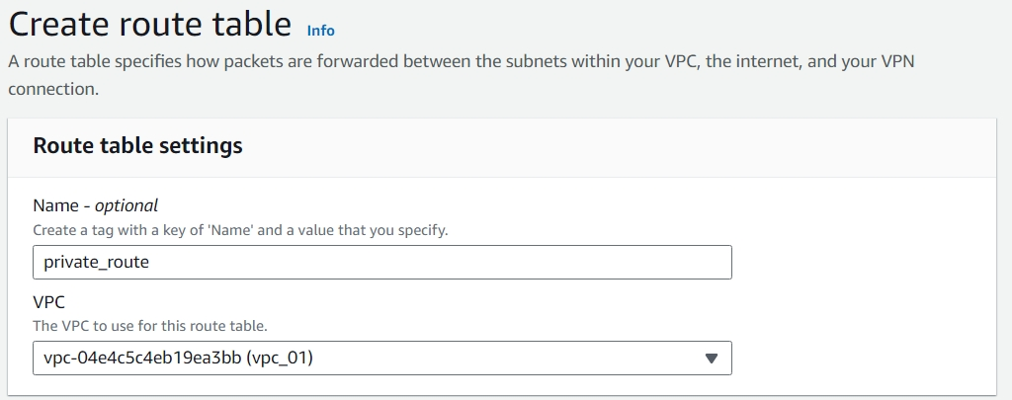

Slide 13
Add Networking Components
Internet Gateway: An Internet gateway is a horizontally scaled, redundant, and highly available VPC component that allows communication between instances in your VPC and the Internet. It therefore imposes no availability risks or bandwidth constraints on your network traffic.
NAT Gateway: Place it in the public subnet and connect it to the private subnets.
How to create an Internet Gateway:
1) Navigate to the AWS console -> Services
2) Under the Networking & Content Delivery section, choose VPC.
3) Navigate to Virtual Private Cloud -> Internet Gateways. Click Create Internet Gateway.
4) Type a name in the Name tag text box and click Yes, Create.
5)Click Attach to VPC and Select your VPC from the Name tag drop-down list and click Yes, Attach.

Slide 14
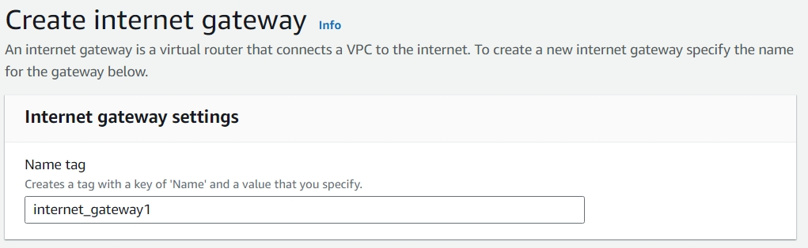
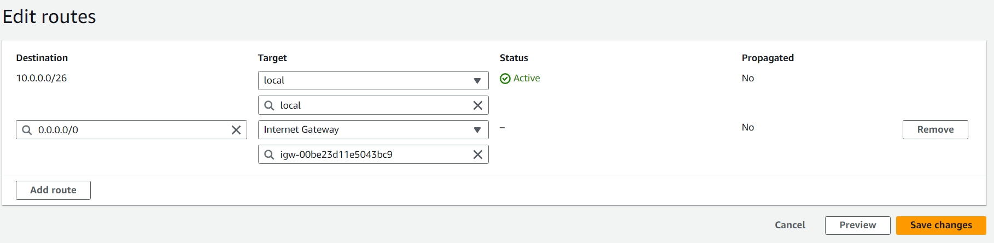

Slide 15
Add EC2 Instances:
Web Servers: Place EC2 instances in the public subnets to handle incoming web traffic.
Application Servers: Place additional EC2 instances in the private subnets for application logic processing.
How to Create a EC2 Instance:
1)Navigate to EC2 Console
2)Click on the launch instance to create the instance
3)Now choose an instance type and select the virtual machine
4)Configure the storage and make sure to tag the instance
5)Access the build in security by creating a required security group
6)Now enable SSH access with a key.

Slide 16
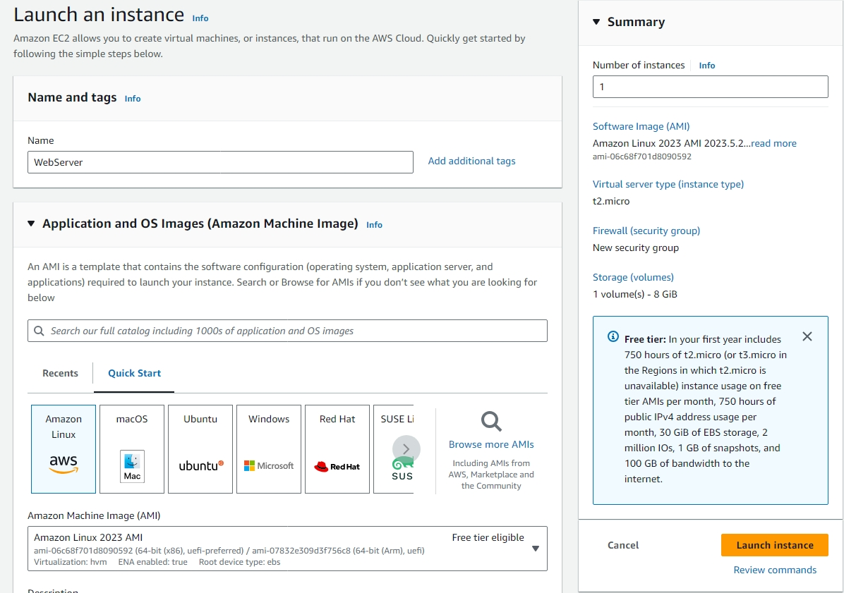
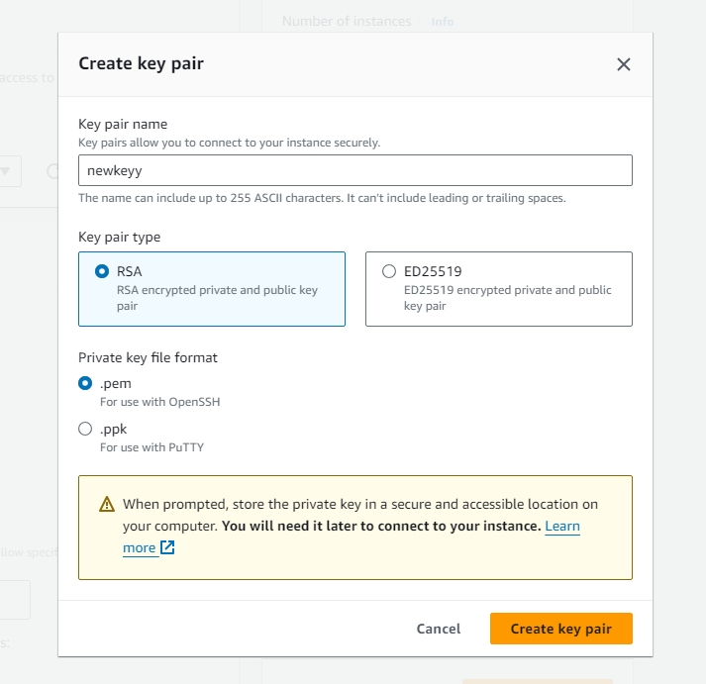

Slide 17
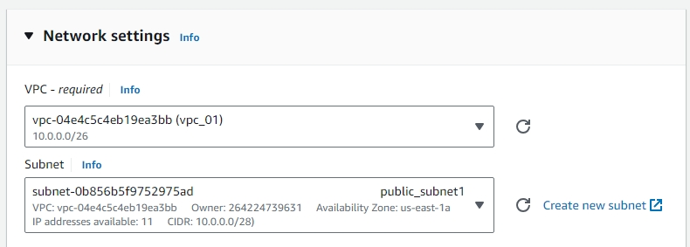

Slide 18
Add Load Balancer:
Elastic Load Balancer: Draw the load balancer above the web servers and connect it to the EC2 instances in the public subnets.
Before creating a load balancer, ensure you have a VPC, subnets, and instances set up.
How to add Load Balancer:
1)Navigate to the EC2 Dashboard and In the left-hand menu under Load Balancing, click on Load Balancers.
2)Select the type of load balancer. For a web application, you'll typically choose Application Load Balancer (ALB) and Click Create.
3)Enter a name for your load balancer. And choose the IP version that is required.
4)Configure Listeners and Routing and Create Target Group
5)Select the EC2 instances you want to include in the target group.
6)Review all the settings you have configured and Click Create.
7)Once created, navigate back to the Load Balancers section in the EC2 dashboard. Select your newly created load balancer and Check the Description tab to ensure that the load balancer is in a state: active.

Slide 19
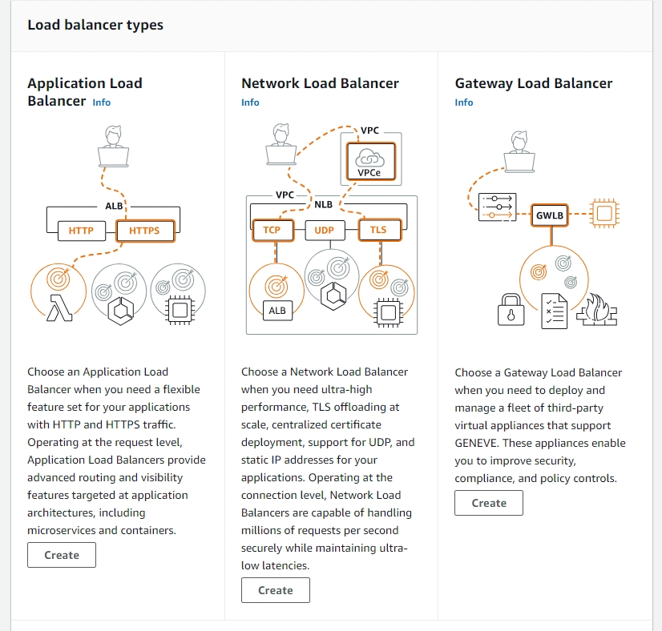
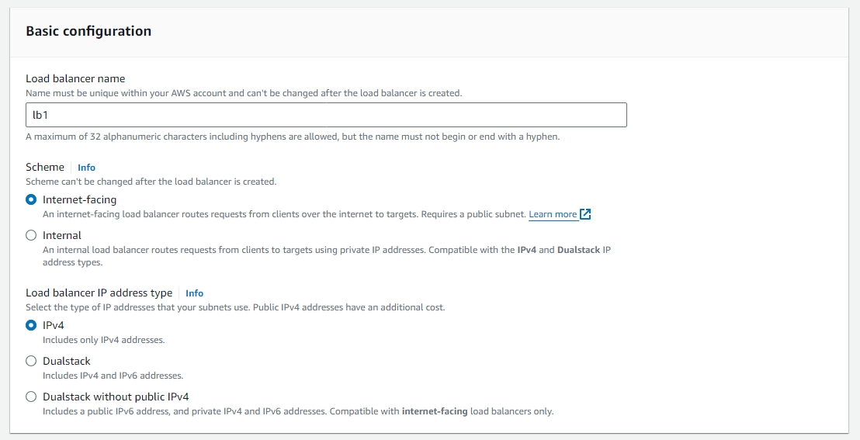
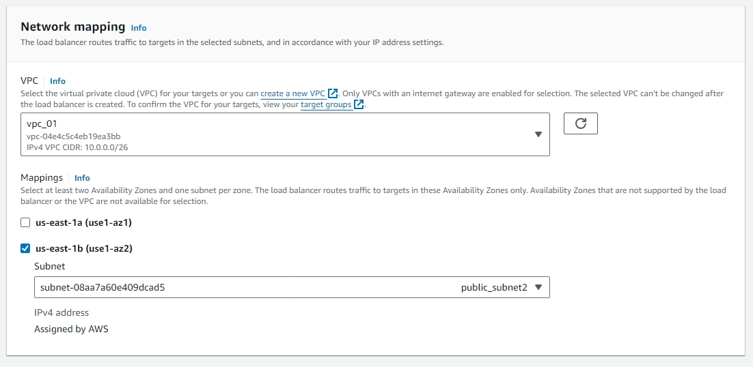

Slide 20
Navigate to the RDS Dashboard
Open the AWS Management Console.
In the Services menu, click on RDS to open the RDS Dashboard.
2. Create a Database
Click on the Create database button.
3. Choose a Database Creation Method
Creation method: Select Standard create for more customization options.
4. Select Engine
Engine options: Choose your preferred database engine (e.g., MySQL, PostgreSQL, MariaDB, Oracle, SQL Server).
5. Specify DB Details
DB instance identifier: Enter a unique name for your database instance.
Master username: Enter a username for the database admin.
Master password: Enter and confirm a strong password for the database admin.
6. Configure Instance
DB instance class: Choose an instance class (e.g., db.t2.micro for free tier eligibility).
Storage: Select the storage type and size. Enable storage autoscaling if needed.

Slide 21
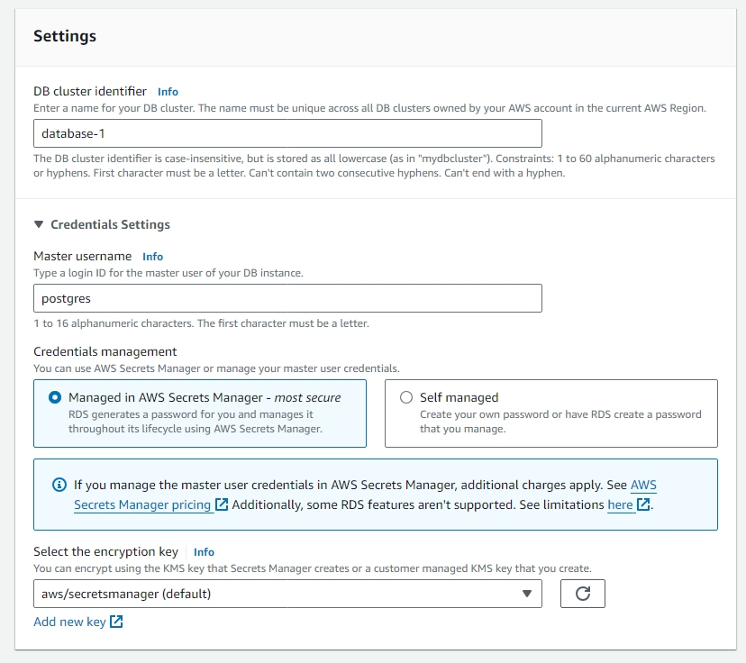
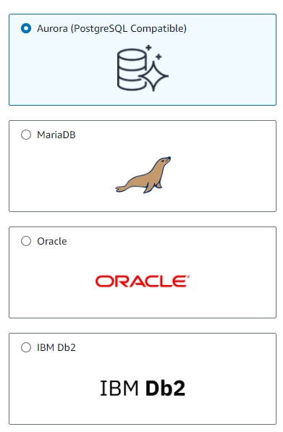

Slide 22
7. Configure Networking
VPC: Select the VPC where your EC2 instances are located.
Subnet group: Choose a DB subnet group.
Publicly accessible: Choose Yes or No based on your security requirements.
VPC security groups: Select or create security groups that allow access from your EC2 instances.
7. Configure Networking
VPC: Select the VPC where your EC2 instances are located.
Subnet group: Choose a DB subnet group.
Publicly accessible: Choose Yes or No based on your security requirements.
VPC security groups: Select or create security groups that allow access from your EC2 instances.
8. Additional Configuration
Database name: Enter a name for your initial database.
Backup retention period: Set the number of days to retain backups.
Enable encryption: Choose whether to enable encryption for your database.
9. Create Database
Review all the settings.
Click the Create database button.
10. Connect to RDS
Endpoint: Copy the RDS endpoint from the RDS Dashboard.
Security groups: Ensure security groups allow inbound traffic on the database port (e.g., 3306 for MySQL).
Database client: Use a database client or application to connect to the RDS instance using the endpoint, username, and password.

Slide 23
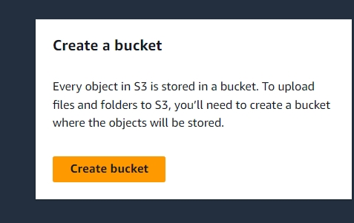
How to create an S3 Bucket:
1)Navigate to the S3 Dashboard
Open the AWS Management Console.
In the Services menu, click on S3 to open the S3 Dashboard.
2. Create a New S3 Bucket
3. Configure Bucket Settings
Bucket name: Enter a unique name for your bucket.
AWS Region: Select the region where you want to create the bucket.
4. Block Public Access settings for this bucket:
Choose whether to block all public access.
If you want public access, uncheck the appropriate boxes.
5. Review and Click the Create bucket button.
6. Upload Files to S3 Bucket
Upload: Click on the bucket name to open it.
Add files: Click the Upload button and add files to the bucket.
Upload settings: Configure settings such as permissions and properties.
Start upload: Click the Upload button to start the upload process.

Slide 24
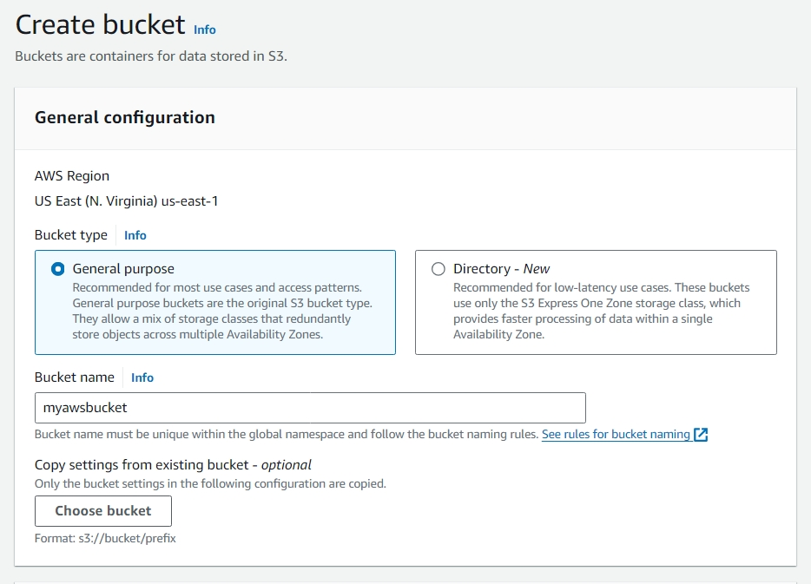
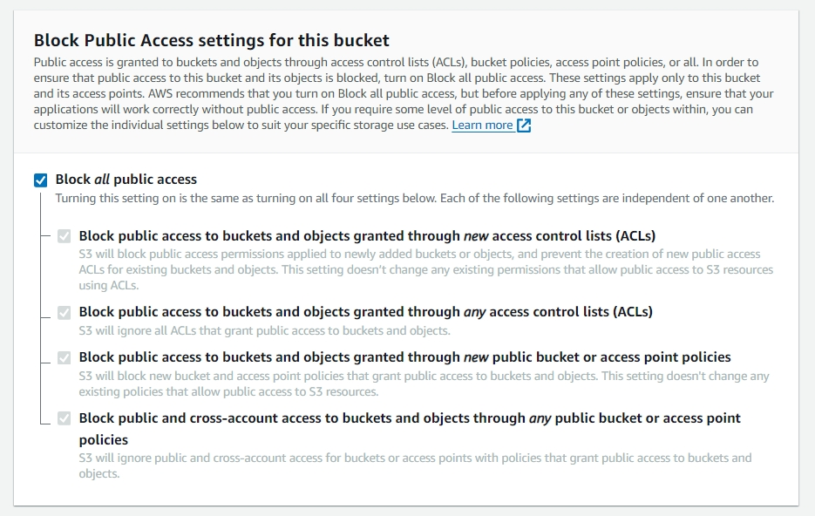
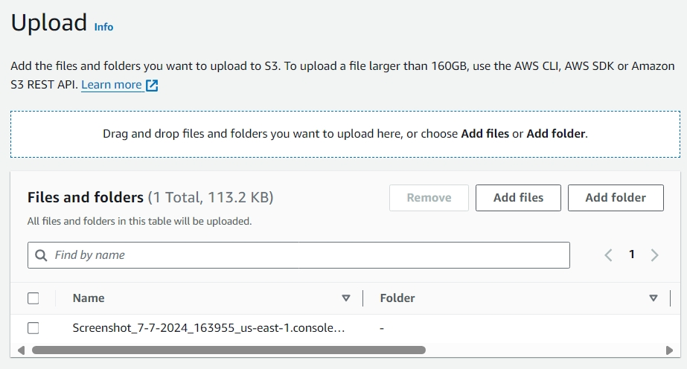

Slide 25
Configuring Route 53 in AWS Console:
1)In the Services menu, click on Route 53 to open the Route 53 Dashboard.
2)Click on the Hosted zones button in the left-hand menu and Click the Create hosted zone button
3) Configure Hosted Zone Settings
Domain Name: Enter the domain name you want to manage (e.g., example.com).
Type: Select Public Hosted Zone for public domains.
Click the Create button.
4)Add Record Sets
Select Hosted Zone: Click on the hosted zone you just created.
Create Record Set: Click the Create Record Set button.
5)Configure A Record for Load Balancer
Name: Leave it blank to use the root domain (e.g., example.com).
Type: Select A - IPv4 address.
Alias: Select Yes.
Alias Target: Select your Elastic Load Balancer from the list.
6)Click the Create button.

Slide 26
Add Security Components
Security Groups:
Illustrate security groups around each component.
Include web servers, application servers, and RDS.
Show traffic rules and restrictions.
Demonstrate how security groups protect each component.
Ensure proper configuration for inbound and outbound traffic.
Add Monitoring and Logging
CloudWatch:
Show CloudWatch connected to all major components.
Include EC2 instances, RDS, and Load Balancer.
Set up CloudWatch to monitor performance metrics.
Configure alarms for critical events and thresholds.
Enable detailed logging for troubleshooting and analysis.

Slide 27
Hosting Your Application and Website on AWS
For hosting your application and website, I recommend using a combination of AWS services that offer scalability, flexibility, security, and cost-effectiveness. Here are the suggested AWS services:
1. Amazon EC2 for Application Hosting
Scalability: Amazon EC2 (Elastic Compute Cloud) allows you to launch and manage virtual servers (instances) to host your application. You can scale your infrastructure up or down based on traffic demands, ensuring your application can handle varying loads efficiently.
Flexibility: You have full control over the configuration, management, and deployment of your servers. This includes the choice of operating system, software, and application stacks, allowing you to customize your infrastructure to meet specific requirements.
Cost-Effective: EC2 offers various pricing models, including On-Demand Instances (pay-as-you-go), Reserved Instances (for long-term predictable workloads), and Spot Instances (for fault-tolerant workloads at a lower cost).
Security: With EC2, you can utilize built-in security features such as Virtual Private Cloud (VPC), security groups, and Identity and Access Management (IAM) roles to secure your application. Data can be encrypted at rest and in transit.
Integration: EC2 integrates seamlessly with other AWS services, such as Amazon RDS for databases, Amazon S3 for storage, and AWS CloudFormation for infrastructure automation.

Slide 28
Amazon S3 for Static Website Hosting
High Availability: Amazon S3 (Simple Storage Service) provides durable and highly available storage for static website content (e.g., HTML, CSS, JavaScript, images). S3 ensures your content is available to users around the globe with 99.999999999% durability.
Amazon RDS for Database Management
Managed Service: Amazon RDS (Relational Database Service) automates time-consuming database administration tasks such as backups, patching, and scaling. This allows you to focus on your application rather than database management.
High Availability: RDS offers Multi-AZ (Availability Zone) deployments to ensure high availability and automatic failover. You can also use Read Replicas to improve performance and scalability.
RDS integrates with other AWS services like Amazon EC2, AWS Lambda, and Amazon CloudWatch for monitoring and logging. AWS Database Migration Service makes it easy to migrate existing databases to RDS.
By using Amazon EC2 for application hosting, Amazon S3 for static website content, and Amazon RDS for database management, you can build a robust, scalable, secure, and cost-effective hosting solution on AWS. This approach leverages the strengths of each service to ensure your application and website perform optimally and securely.

Slide 29
Recommended Security Platform for Your Application and Website on AWS
To ensure the security of your application and website hosted on AWS, a multi-layered security approach is recommended. Here are the key AWS security services and features that can be utilized to create a robust security platform:
1. AWS Identity and Access Management (IAM)
User Management: Create and manage AWS users and groups and use IAM policies to grant precise permissions to resources.
Role-Based Access Control: Use IAM roles to manage access permissions for different users or services, ensuring the principle of least privilege.
Multi-Factor Authentication (MFA): Enhance account security by requiring MFA for sensitive operations.
2. Amazon Virtual Private Cloud (VPC)
Network Isolation: Use VPC to isolate your application and database in a private network, protecting them from direct internet access.
Subnets: Create public and private subnets to control access to resources. Place application servers in private subnets and only expose necessary endpoints.
Network Access Control Lists (ACLs): Implement ACLs to add an additional layer of security by controlling inbound and outbound traffic at the subnet level.

Slide 30
4. AWS Web Application Firewall (WAF)
Protection Against Common Threats: Use AWS WAF to protect your web applications from common web exploits such as SQL injection and cross-site scripting (XSS).
5. AWS Shield
DDoS Protection: AWS Shield provides managed Distributed Denial of Service (DDoS) protection to safeguard your applications against volumetric attacks.
6. AWS CloudTrail
Audit and Compliance: Enable AWS CloudTrail to log and monitor API calls across your AWS account. This helps in auditing, compliance, and detecting unusual activities.
7. Amazon GuardDuty
Threat Detection: Use Amazon GuardDuty to continuously monitor for malicious or unauthorized behavior in your AWS environment.
8. AWS Config
Configuration Management: Use AWS Config to monitor and record configuration changes in your AWS resources.
By implementing these AWS security services and features, you can build a comprehensive security platform that protects your application and website from a wide range of threats. This multi-layered security approach ensures that your resources are well-protected, compliant with regulations, and resilient against potential attacks.

Slide 31
CONCLUSION
When considering storage options using AWS services, here are some commonly used databases:
Amazon RDS (Relational Database Service): Ideal for traditional relational databases like MySQL, PostgreSQL, SQL Server, etc., providing automated backups, scaling, and high availability.
Amazon Aurora: A MySQL and PostgreSQL-compatible relational database built for the cloud with performance and scalability enhancements over standard RDS.
Amazon DynamoDB: A fully managed NoSQL database service for applications requiring single-digit millisecond latency at any scale. It's ideal for document and key-value storage.
Amazon Redshift: A fully managed data warehouse service that makes it simple and cost-effective to analyze all your data using SQL and existing BI tools.
Amazon Document DB (with MongoDB compatibility): A fast, scalable, highly available, and fully managed document database service that supports MongoDB workloads.
Amazon Neptune: A fast, reliable, fully managed graph database service that makes it easy to build and run applications that work with highly connected datasets.
Each of these databases has its strengths depending on your application's specific needs for scalability, performance, and data structure requirements.

